Slide 1

Embedded Indoor Positioning System
Student:
Alistar Stefan
Project Coordinator:
SL.dr.ing Harja Gabriel

Slide 2
Contents
Motivation
Objectives
Ultra wide-band
Hardware implementation
Software & testing
Trilateration
Results
Conclusion

Slide 3
Motivation
GPS only works outdoors
The need for a cost-effective and accurate IPS
Answering a growing demand in:
Factories – determining location of robots
Medical domain – monitoring sick patients
Emergency situations – guiding firemen inside buildings
Human logistics – guiding people in airports

Slide 4
Objectives
Design a circuit to enable transmitting and receiving distances
Design a custom PCB for the components
Use dedicated software to enable ranging between devices
Enable trilateration for determining a device position
Show coordinates in real-time using a GUI like MATLAB
Further calibrate the antennas

Slide 5
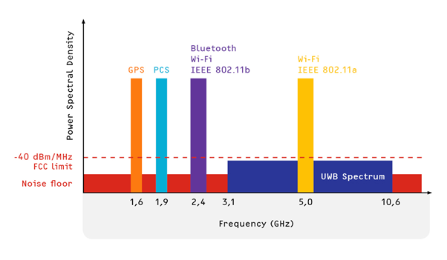
Ultra Wide-band (UWB)
Wireless communication protocol that uses radio waves
Used by U.S. military for decades, popularized in 2019
Time-of-Flight and Received-Signal-Strength
Frequency range: 3.1-10.6 GHz
https://www.everythingrf.com/community/what-is-ultra-wide-band-uwb-technology

Slide 6
Hardware implementation

Slide 7
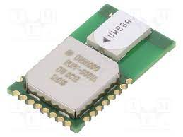
Decawave’s DWM1000
Enables UWB communication
SPI protocol
Data rates of up to 6.8 Mbps
Up to 64 MHz clock frequency
10 cm accuracy and range of up to 290m in LoS and 35m in NLoS
https://www.tme.eu/ro/details/dwm1000/module-rf/decawave/

Slide 8
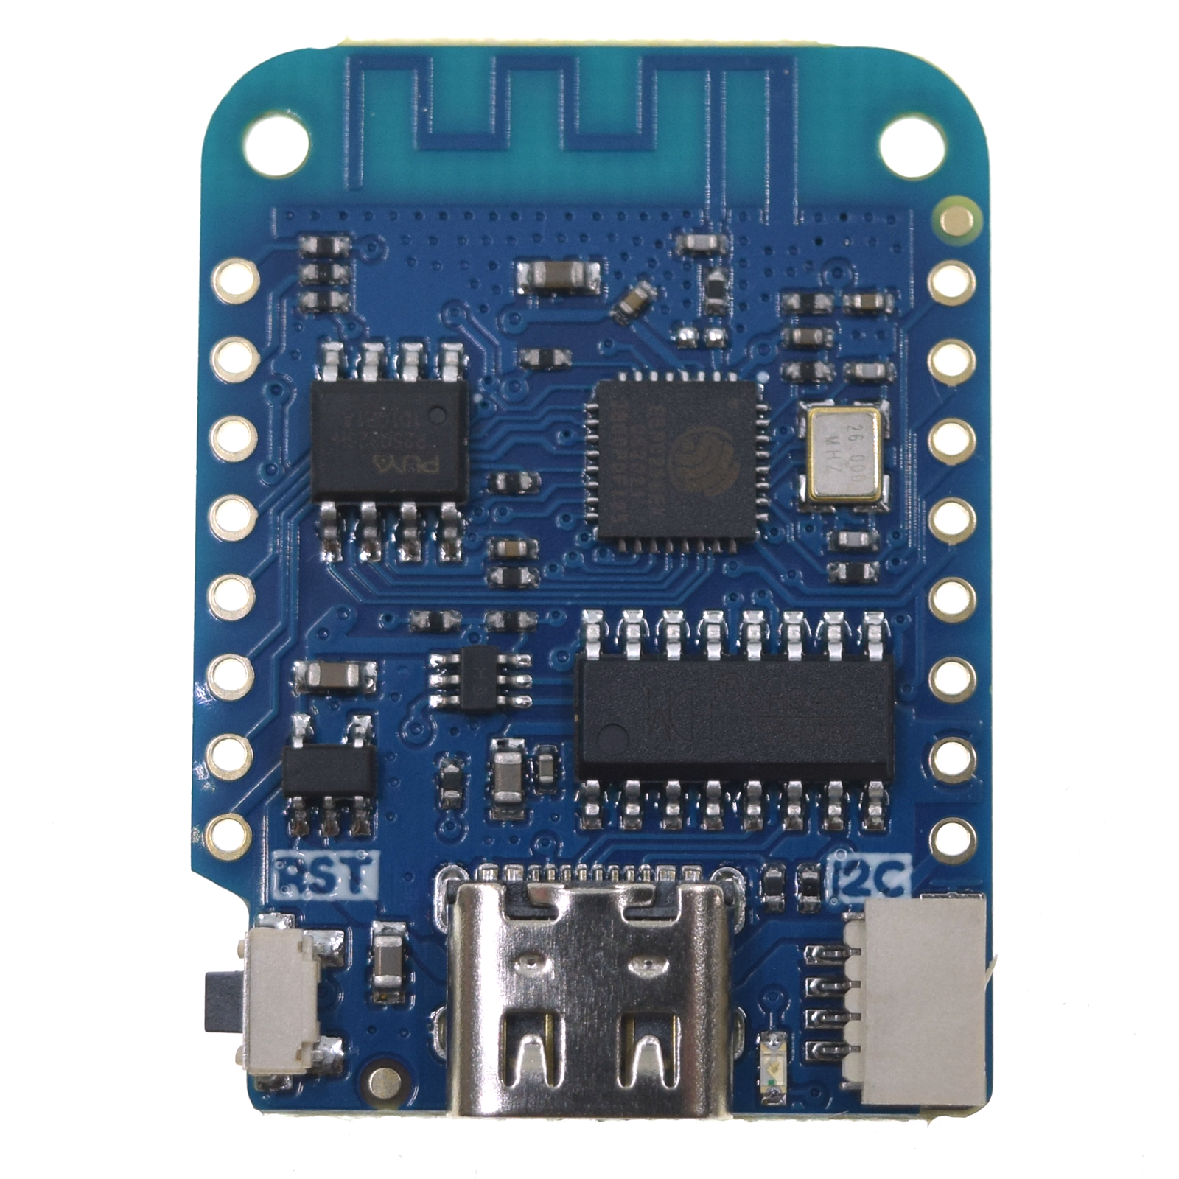
Wemos D1 Mini & additional components
Wemos D1 Mini: microcontroller used to process data received from DWM
Powerful ESP8266-based board: 80/160MHz, 4MB flash memory
Uses SPI protocol to communicate with the DWM module
3.3 V regulator for powering the DWM via a Wemos pin
10 kΩ pull-down resistor linked to IRQ pin to prevent sporious interrupts
https://www.wemos.cc/en/latest/d1/d1_mini.html

Slide 9
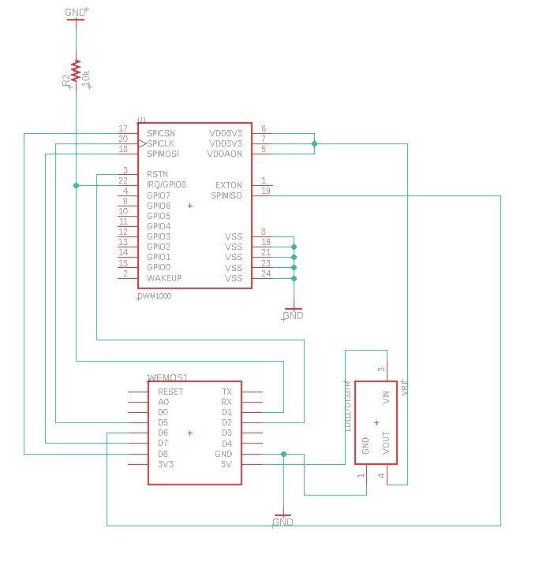
Circuit design
SPI pins:
CS (chip-select): to activate the SPI
CLK (Clock): tells the receiver when to sample the bits
MOSI & MISO (Master Out Slave In & Master In Slave Out): input/output signals
3.3V & GND pins
IRQ
RST

Slide 10
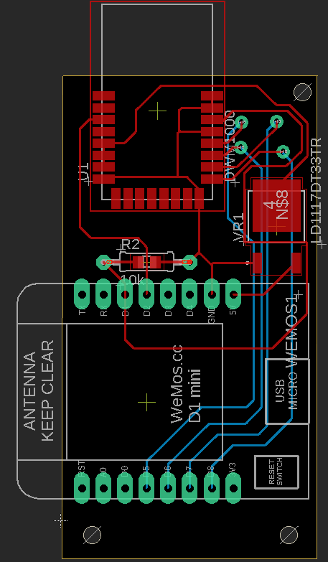
PCB
Designed respecting the circuit
Used Autodesk EAGLE and Fusion360
Compact: 5.6x3 cm
Respected antenna placement

Slide 11
Software & Testing

Slide 12

Arduino IDE
Dedicated software library
Calibration capabilities
Ability to customize DWM configuration

Slide 13
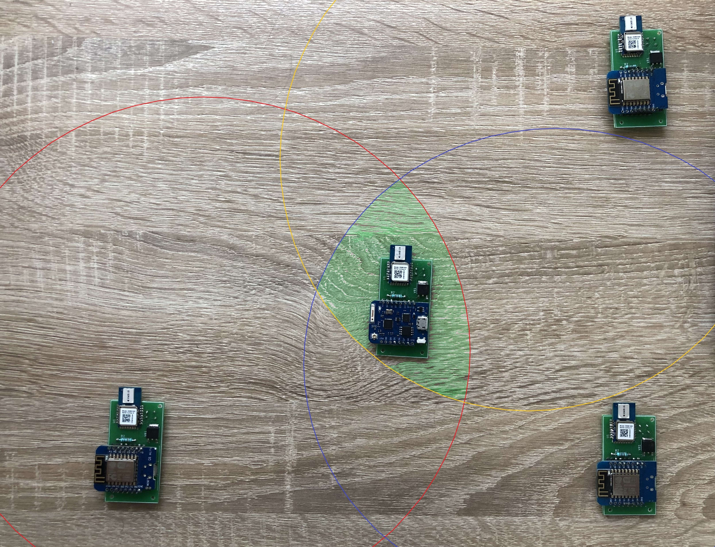
Testing & Algorithm used
In order to obtain the user position, 4 devices were built (3 anchors and 1 tag) to enable the trilateration algorithm
Steps:
Check connectivity with the DWM
Implement two-way ranging
Implement trilateration

Slide 14
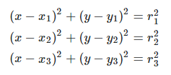
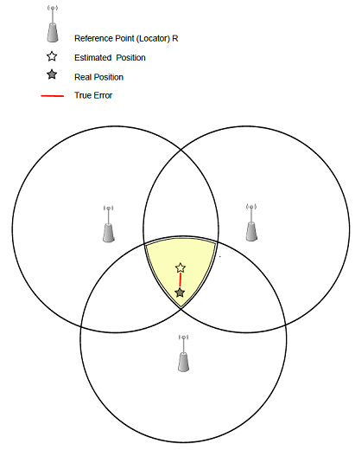
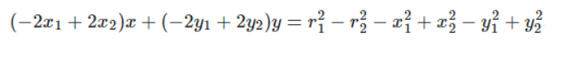
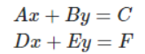
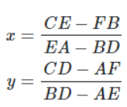

Trilateration
= User coordinates

Slide 15
Results
Achieved an accuracy of 10-20 cm in Line-of-Sight
Received consistent results, with rare signal loss scenarios
Works outdoors with a range > 100m

Slide 16
Conclusion
Designed a cost-effective Indoor Positioning System
Built a compact PCB
Achieved precision of 10-20 cm

